Slide 1

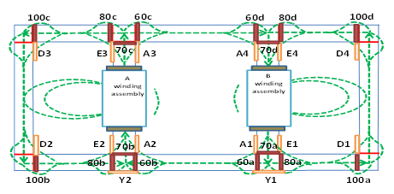

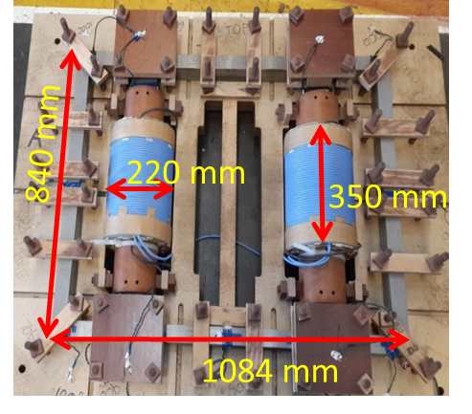

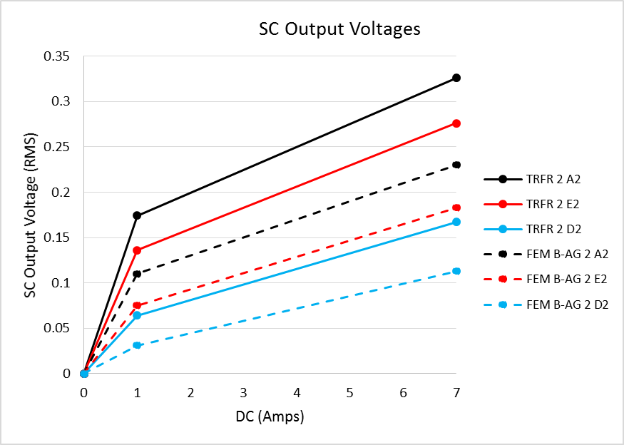

ARWtr2016
Advanced Research Workshop on Transformers. (2)3 -5 October 2016. La Toja Island– Spain
Measurements and finite element model of transformer core joints with dc and ac excitation
HK Chisepo and CT Gaunt, University of Cape Town, South Africa
LD Borrill, Eskom, South Africa
Background
GIC enter PTNs through Power Transformers as quasi-dc currents (f < 1 Hz)
Half-cycle saturation = many unwanted conditions in PTNs
Stray flux = hot spots, insulation degradation and gassing
Factory Testing with dc not practically feasible – excessive draw of Mvars
GIC withstand design models are needed but validation with measurement data is the challenge
Approach
Laboratory flux measurements with 3X1p-4L transformers [1]
Nominal ac applied + various dc levels with search coil measurements
FEM models with different core joint detail investigated
FEM S model with solid joints
One single-phase four limb laboratory transformer -
110/206 V, 4.4 kVA.
FEM B-AG model with “equivalent air gaps” at the joints
Results
Measured (TRFR 2) and FEM B-AG air SC output voltages with simultaneous ac and dc excitation
Conclusions
FEM models calibrated with ac measurement data
No search coil outputs for solid joint FEM model with ac + dc
“Equivalent air gap” FEM models give results closer to those measured with ac + dc together
More detailed numerical modelling needed for more accuracy - anisotropy
[1] L. D. Borrill, H. K. Chisepo and C.T. Gaunt, Flux measurements with ac and dc components of current present show transformer equivalent circuit models need core joint details, In Proc. IEEE POWERCON, Wollongong, Australia, Sept. 2016
hchisepo@gmail.com

